Slide 1
Information classification - Green
Scaling with LaunchDarkly:
A feature toggle story
May 2022

Slide 2


Scaling with LaunchDarkly
Contents
01 | Who we are
02 | Our journey with feature toggles
03 | Why we moved to LaunchDarkly
04 | How we are using LaunchDarkly
05 | Our roadmap
06 | Final thoughts
Information classification - Green

Slide 3

Scaling with LaunchDarkly
Who we are
3

Slide 4
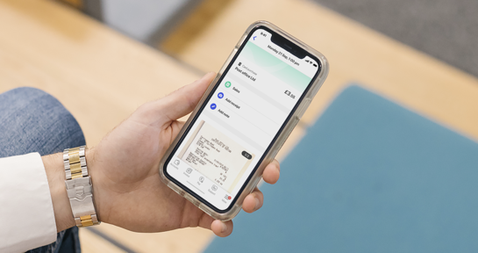
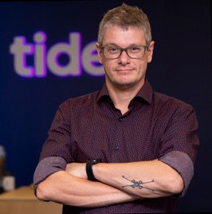

Scaling with LaunchDarkly | Who we are
Who am I
A technologist and a product engineer
A servant leader
A dad

Slide 5
Scaling with LaunchDarkly | Who we are
Few stats about me
70% Athenian
30% Londoner
16+ years
Born in Athens, Greece and lived there for a long time
Been living in London, UK for some time now
Being a Software Engineer & Technology Leader
5+ years
25th Employee
9th Engineer
My tenure at Tide
Joined Tide very early
Joined Tide very early
5

Slide 6
Scaling with LaunchDarkly | Who we are
Tide’s journey
The beginning
Bulgaria & Series B
Globalisation
Occupies a tiny office in London
Works with remote vendors, Ukraine (iOS), Bulgaria (Android), South Africa (Backend)
Tide enters hyper growth mode.
2nd Tide tech centre opens in Sofia, Bulgaria.
Series B closes,
Tide scales rapidly.
Starts hiring people remotely and across multiple locations.
Product scales globally.
2017
2020-2021
A
B
C
D
2015-2016
UK launch & Series A
2018-2019
India & Series C
2022+
Tide launches in January 2017 for iOS, soon after for Android.
Series A closes.
Scaling starts.
3rd tech centre opens in Hyderabad, India.
Tide enters India market.
Series C closes.
Rapid scaling continues
6

Slide 7

Scaling with LaunchDarkly | Who we are
We help our members save time (and money) by building the
leading business financial platform
Mission
Vision
Tide
Tide is on a mission to save business owners time (and money) so they can get back to doing what they love.
To become the world's leading Business Financial Platform available to 25% of the world’s SMEs.

Slide 8
Scaling with LaunchDarkly
Our feature toggles journey
Confidential | Do not distribute
8

Slide 9
Scaling with LaunchDarkly | Our feature toggles journey
The early days
01
Release cadence Releasing every 6-8 weeks
02
Quality Multiple hotfixes per release
03
Team happiness Releasing was a very stressful process
9

Slide 10


Scaling with LaunchDarkly | Our feature toggles journey
Do you mean merging incomplete code back in develop? Are you serious?
10

Slide 11


Scaling with LaunchDarkly | Our feature toggles journey
Our in-house solution
Our in-house solution provided basic functionality like targeted releases, percentage rollouts, circuit breakers and kill switches.
Restricted access
Inconsistent tooling
Only backend engineers could toggle flags or make changes and we were experiencing bottlenecks in delivery.
We had no capability for experiments and we had to use Firebase for A/B testing
11

Slide 12
Scaling with LaunchDarkly | Our feature toggles journey
Fast forward to today
01
Release cadence Releasing consistently every week (by choice)
02
Quality Average of 1 hotfix per 10 releases
03
Team happiness Releasing is stress free
12

Slide 13
Scaling with LaunchDarkly
Why we moved to LaunchDarkly
13

Slide 14
Scaling with LaunchDarkly | Why we moved to LaunchDarkly
01
Automation We wanted to automate manual processes
02
Integrations We wanted to integrate with other tools and services.
03
Delegation We wanted to enable non-engineers to make changes and speed up our processes.
04
Auditing We wanted the ability to go back in time and investigate errors, changes, misbehaviours etc.
05
Insights & Data We wanted to have better insights on our flags, tests and ability to export the data.
06
Better experimentation We wanted more sophisticated experimentation tooling.
14

Slide 15


Scaling with LaunchDarkly | Why we moved to LaunchDarkly
A Buy VS Build decision
OR
15

Slide 16
Scaling with LaunchDarkly | Why we moved to LaunchDarkly
We could build everything ourselves but we prefer spending our time and effort in building products for our members!
Tide Engineering Team
16

Slide 17
Scaling with LaunchDarkly
How we are using LaunchDarkly
17

Slide 18


Scaling with LaunchDarkly | How we are using LaunchDarkly
Building, Deploying, Releasing
Decoupling deployments from releases
Deployment != Release
Testing in Production
Target & canary releases, percentage rollouts
18

Slide 19




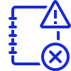
Scaling with LaunchDarkly | How we are using LaunchDarkly
Operations
Kill Switches
Ability to turn products on and off
Migrations
Migrating to new providers, new services, new tools etc.
Bi-directional
Pulling and pushing flag changes
Configurations
Configuring the system based on location, member data
Audit logs
Ability to audit changes and investigate errors or misbehaving flags
19

Slide 20


Scaling with LaunchDarkly | How we are using LaunchDarkly
Experimenting
A/B testing
Testing validity of different variations of a product
Beta Testing
Getting early feedback on a beta version of a new product
20

Slide 21
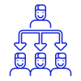
Scaling with LaunchDarkly | How we are using LaunchDarkly
Enabling
Delegating responsibility
Enabling non-engineers to make changes
21

Slide 22
Scaling with LaunchDarkly
Our roadmap
22

Slide 23



Scaling with LaunchDarkly | Our roadmap
Approvals
More secure processes around changing flash in production
Automatic toggling
Integrating with DataDog and automating toggling
Business Rules
Configurations based on business rules
23

Slide 24



Scaling with LaunchDarkly | Final thoughts
Value of moving to LaunchDarkly
Faster improvement and modernization of processes
Scaling the product safely and securely
Scaling the teams and improving their efficiency
Focusing on helping our members
Platform
24

Slide 25
Scaling with LaunchDarkly
We need help with:
Optimising workflows for development at scale
DORA metrics for mobile application development
25

Slide 26
Scaling with LaunchDarkly
Giorgos Ampavis
giorgos.ampavis@tide.co
Twitter: ampav_is
Linkedin: ampavis
26

Slide 27


Creating the financial OS for SMEs
Tide

